Slide 1
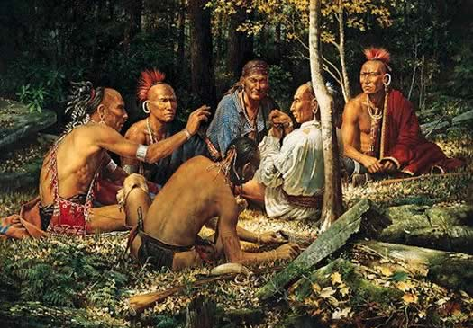
Native Americans
Of North America
Part 3

Slide 2
Reflect
What made it possible for Paleo-Indians to settle down and not have to move around as much as during an earlier time?
Share with a partner.

Slide 3
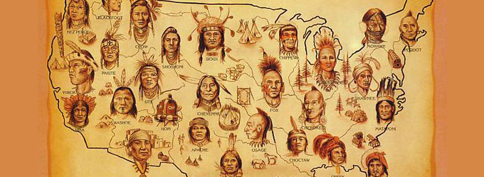
Paleo-Indians’ descendants became known as American Indians or Native Americans.

Slide 4
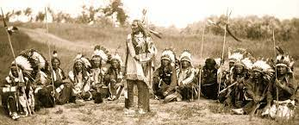
No one knows exactly how many Native Americans there were before European contact but estimates range anywhere from 900,000 to 18 million people living north of the Rio Grande River.

Slide 5
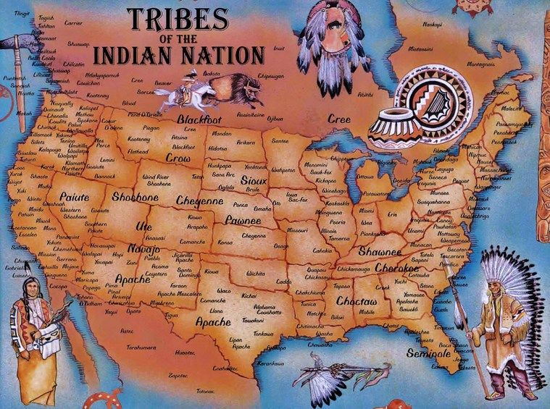
These Native Americans lived in groups called tribes. There were many tribes in North America.

Slide 6
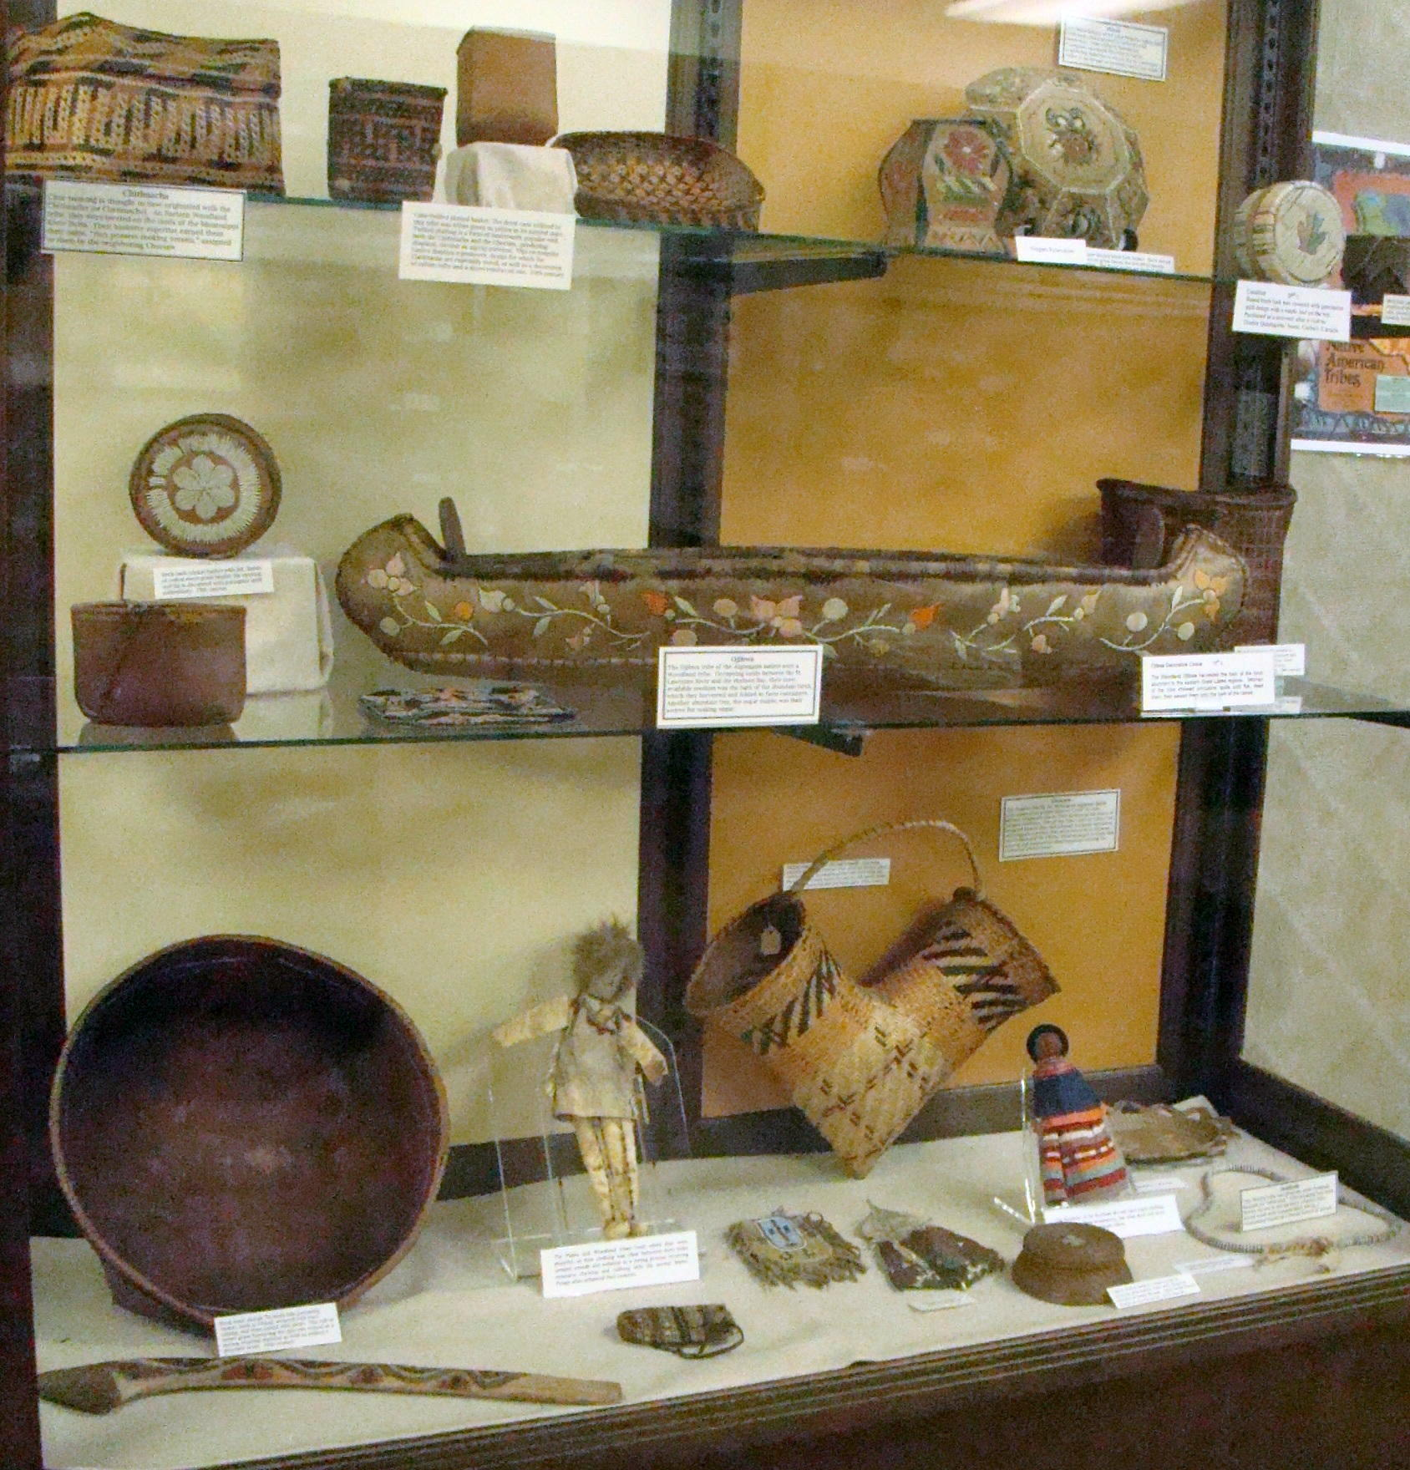
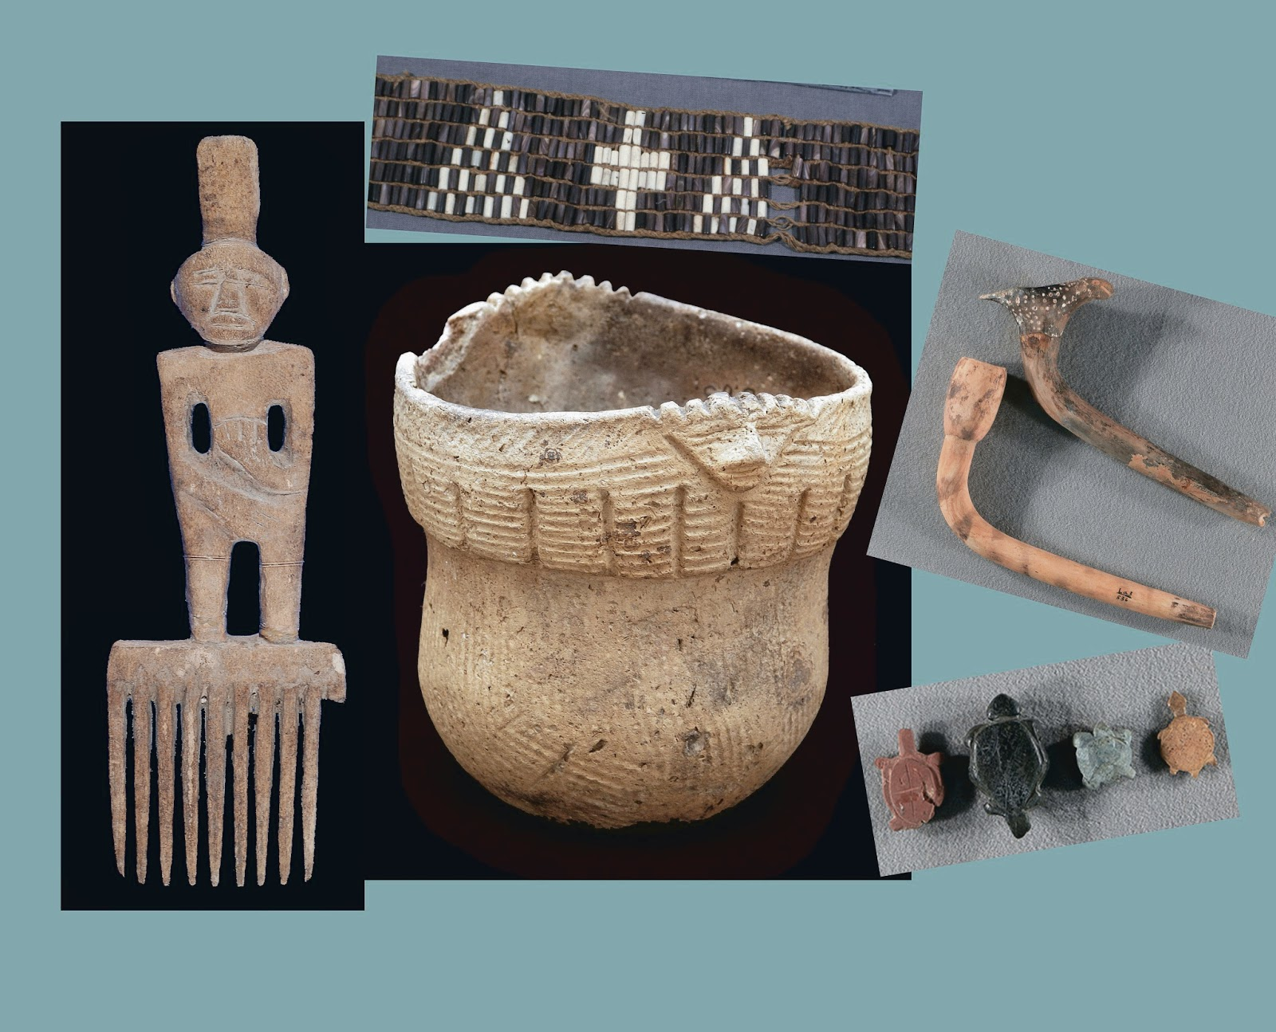
We know about these Native American tribes from stories that have been passed down and artifacts that have been found.

Slide 7
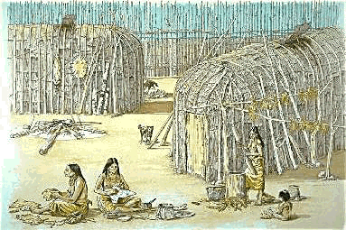
Many of those tribes were divided into small villages called clans.

Slide 8
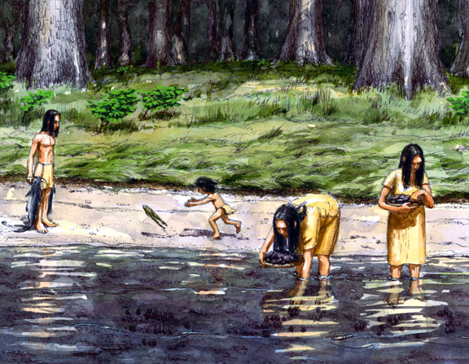
These Native Americans got everything they needed to survive from nature.

Slide 9
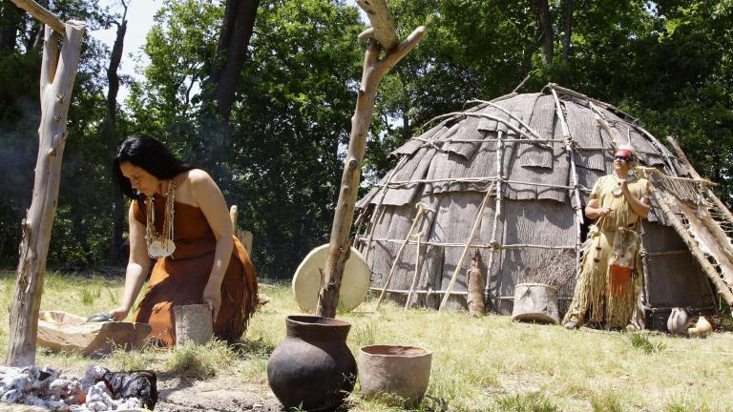
The type of environment these people lived in greatly affected how they lived their lives.

Slide 10
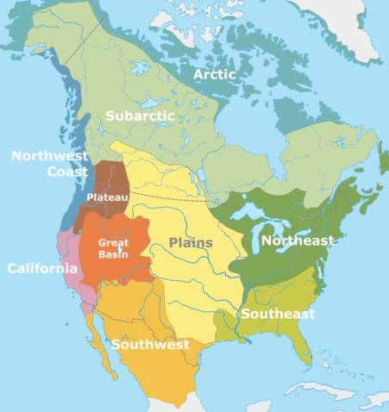
Tribes living in the same type of environment had many similarities.

Slide 11
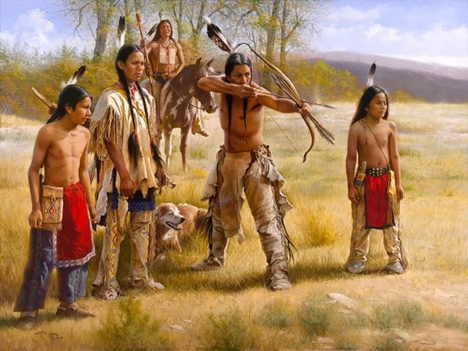
Some of these similarities included the food they ate, what their homes were made from, and the types of clothing they wore.

Slide 12
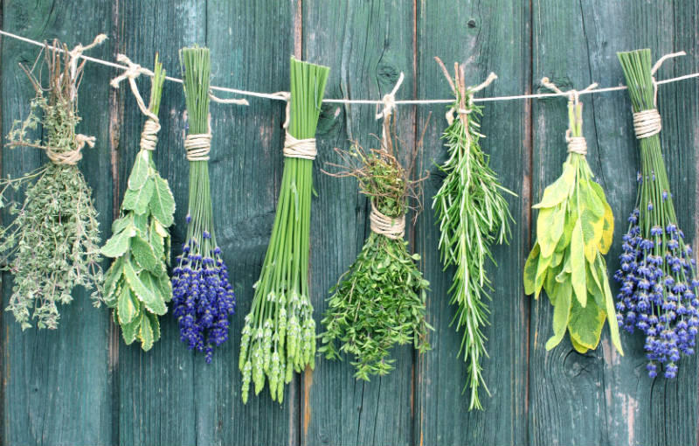
Native Americans used plants from the forest for medicine.

Slide 13
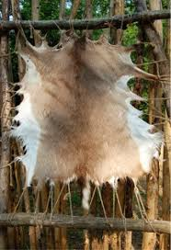
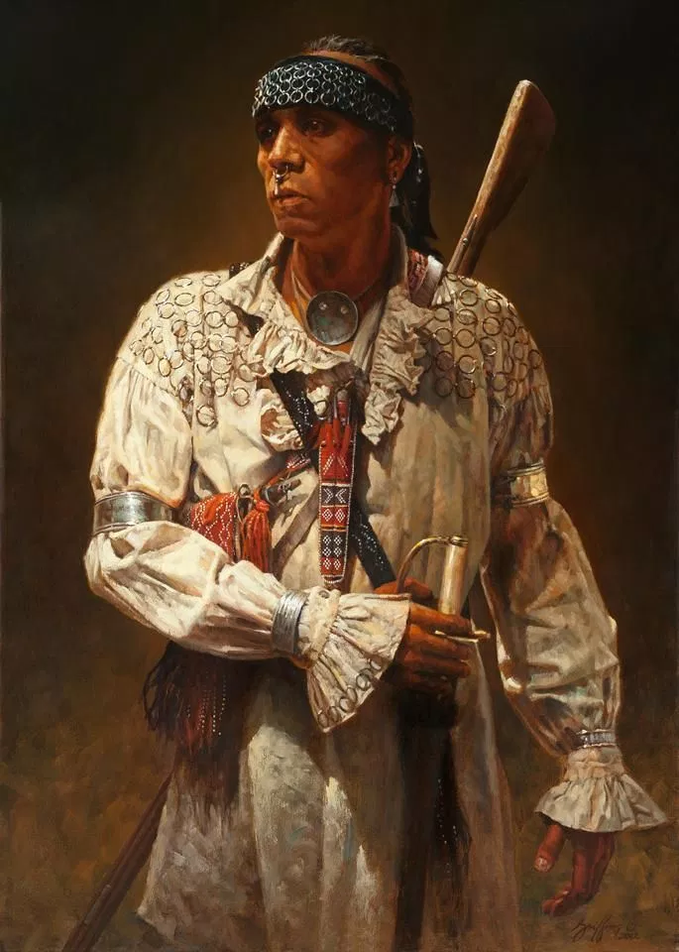
The clothing they wore came from the skins of the animals they hunted.

Slide 14
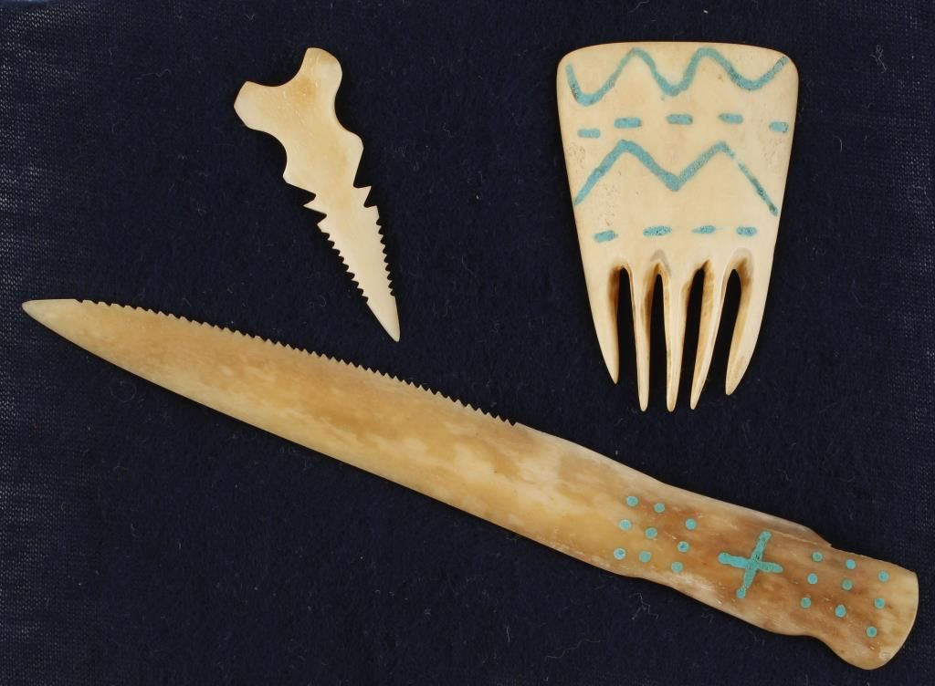
Native Americans used all parts of the animals they killed for many different purposes.

Slide 15
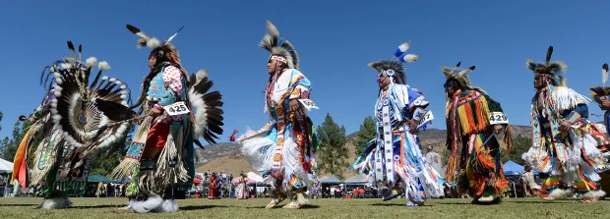
These tribes also had some differences like the languages they spoke, their religion and customs, and how their tribes were organized.

Slide 16
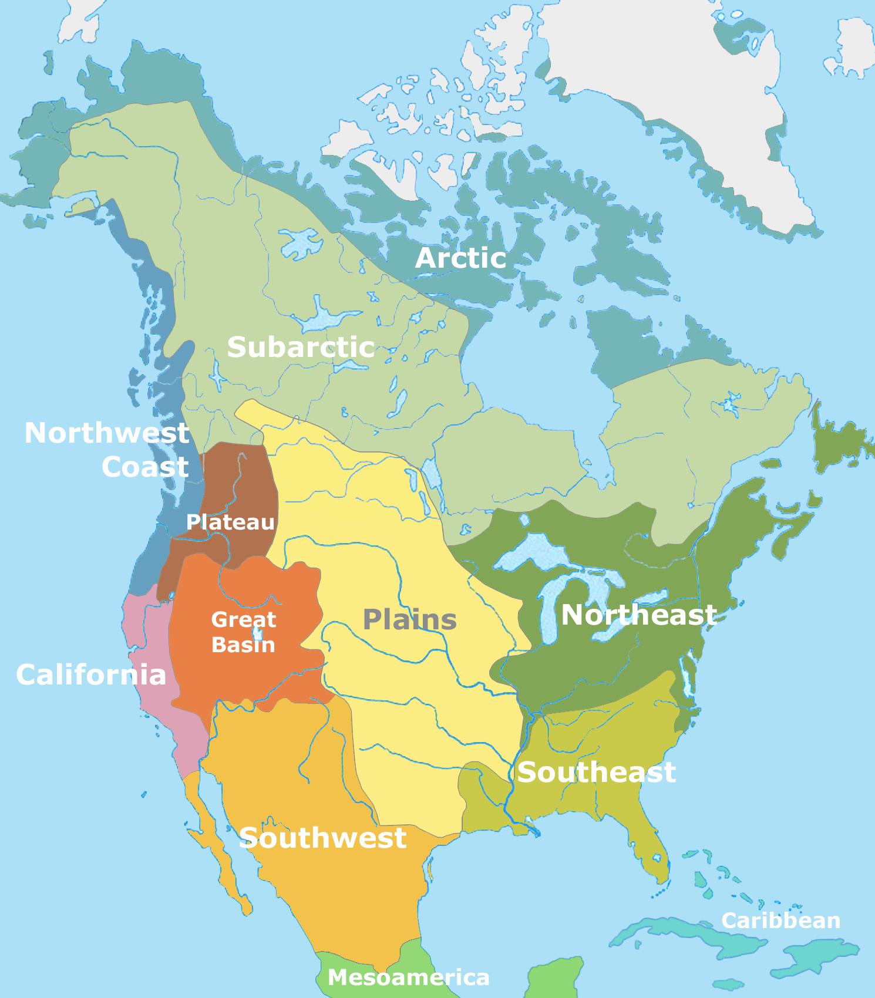
Native American Cultural Areas

